Slide 1
Opportunities of observing at ESO
How to write a successful proposal
Bruno Leibundgut

Slide 2
European Southern Observatory
Mission
  Develop and operate world-class observing facilities for astronomical research
  Organize collaborations in astronomy
Intergovernmental treaty-level organization
  Founded in 1962, by 5 countries
  Currently 14 member states, Brazil in process of ratification
Observatories in Chile
  Optical/infrared: La Silla and Paranal
  Sub-mm: APEX and ALMA partnerships on Chajnantor
HQ in Garching and Office in Santiago

Slide 3
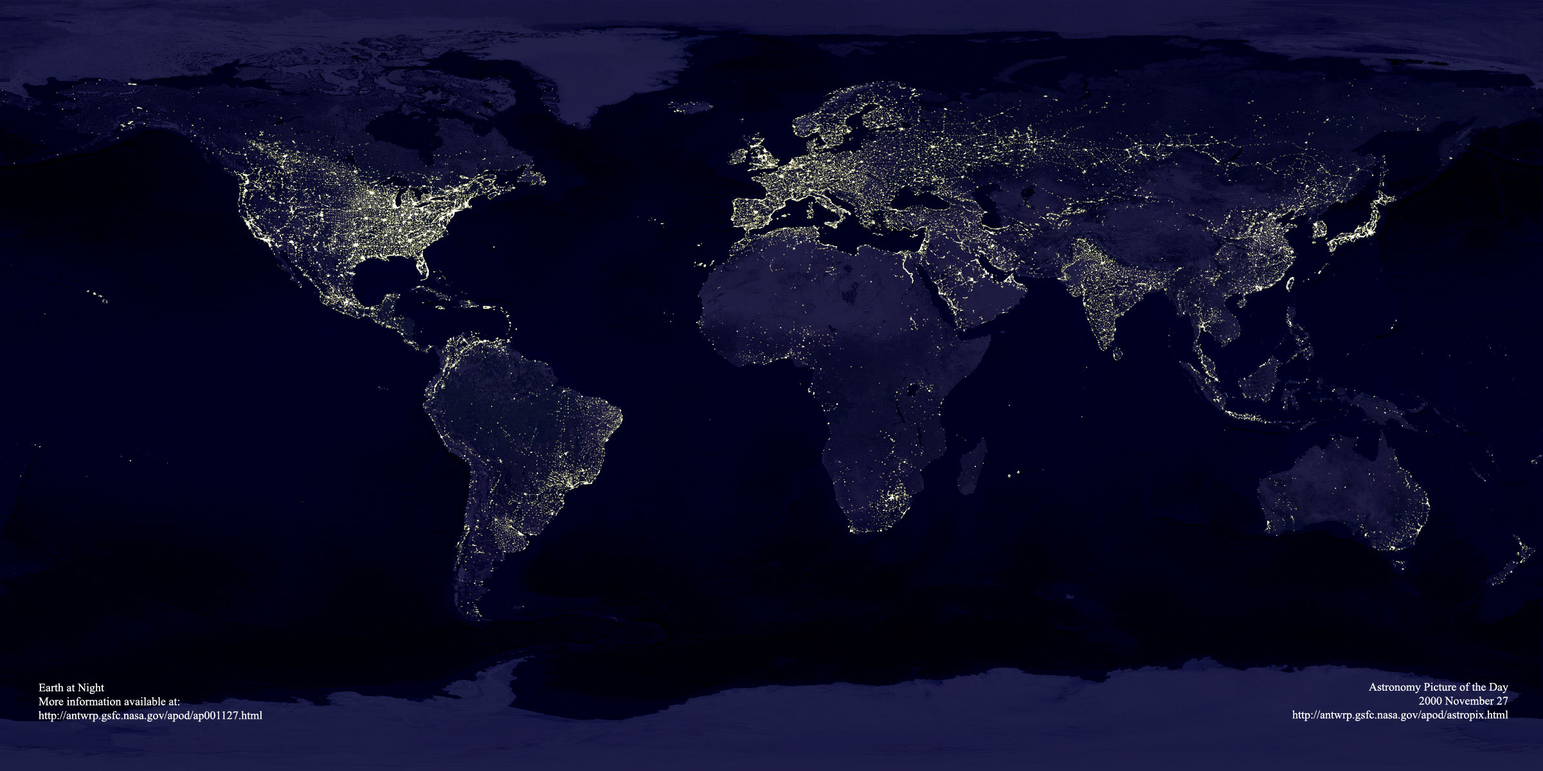
ESO’s world
ESO’s sites
Garching bei München
Chajnantor
Paranal
La Silla
Santiago

Slide 4
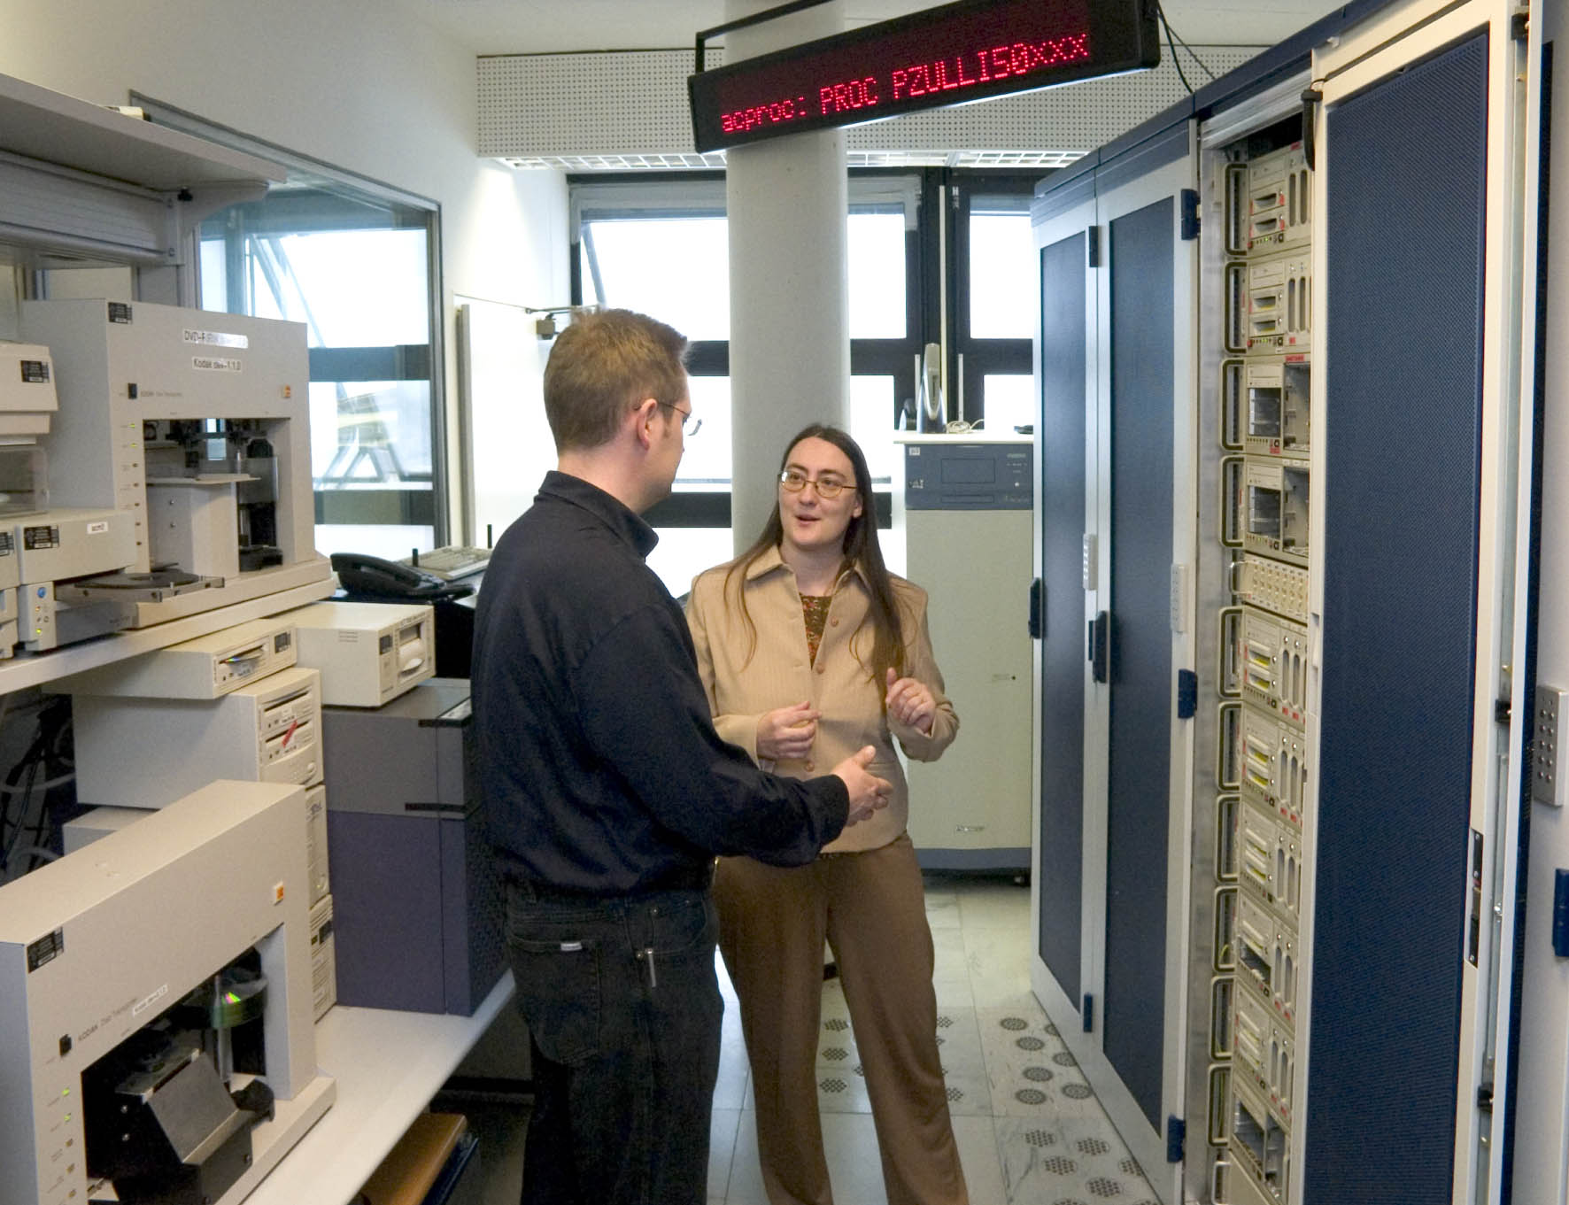
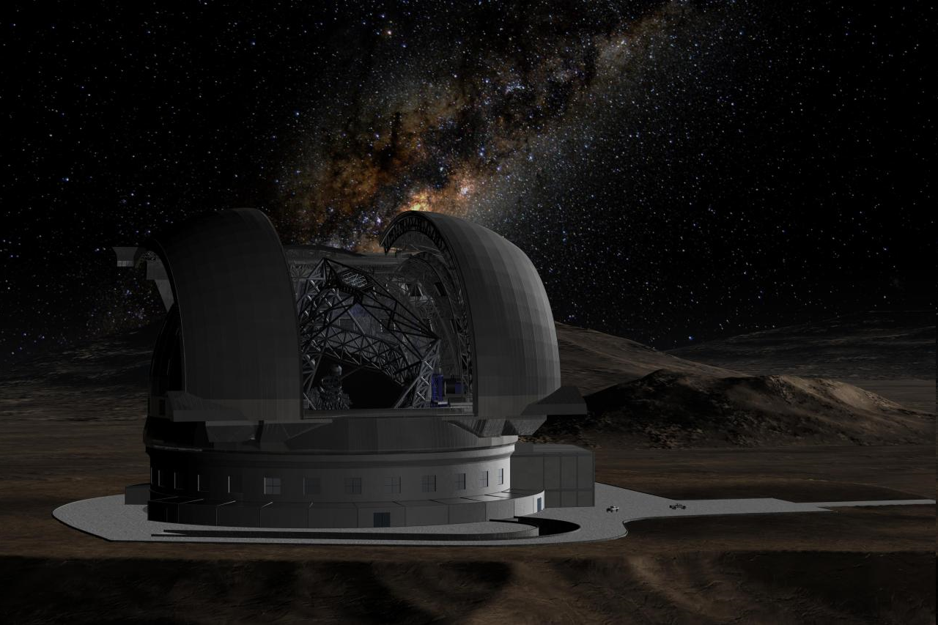
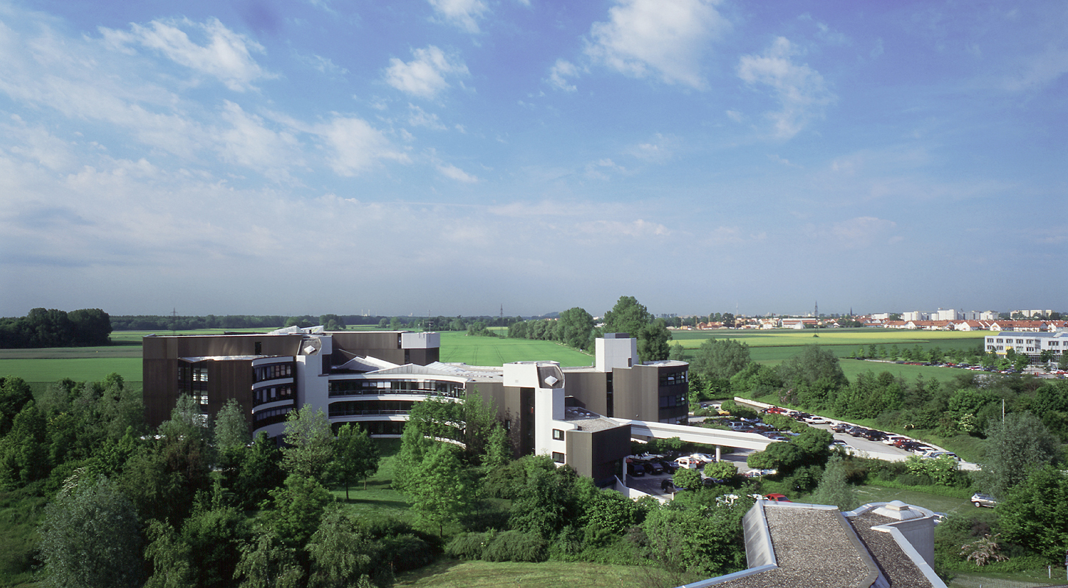
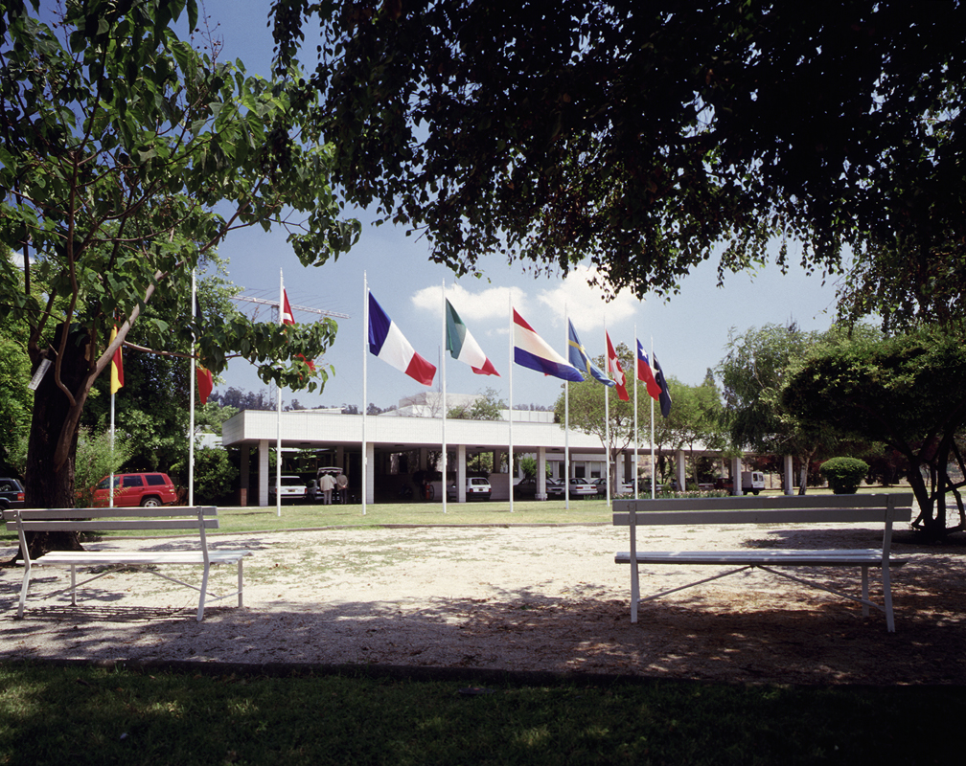
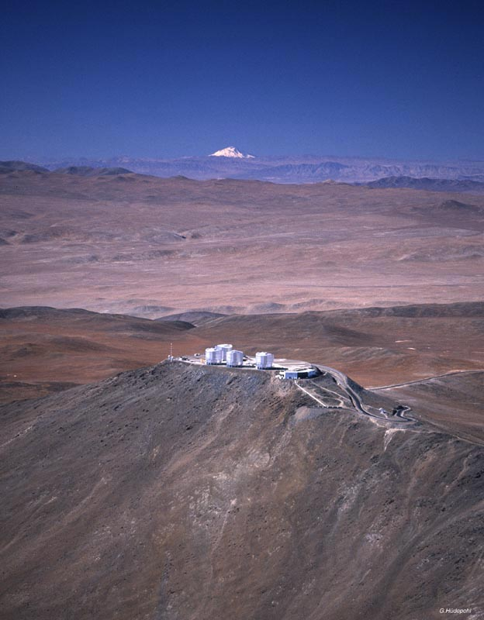
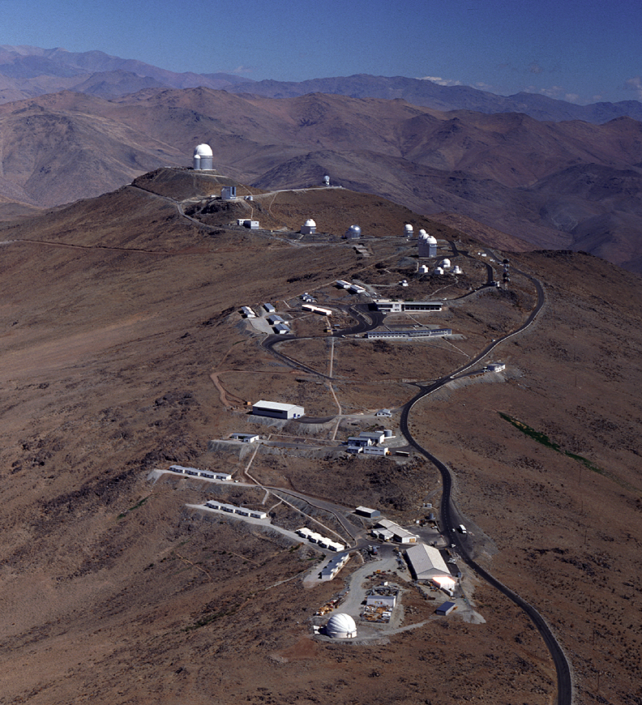
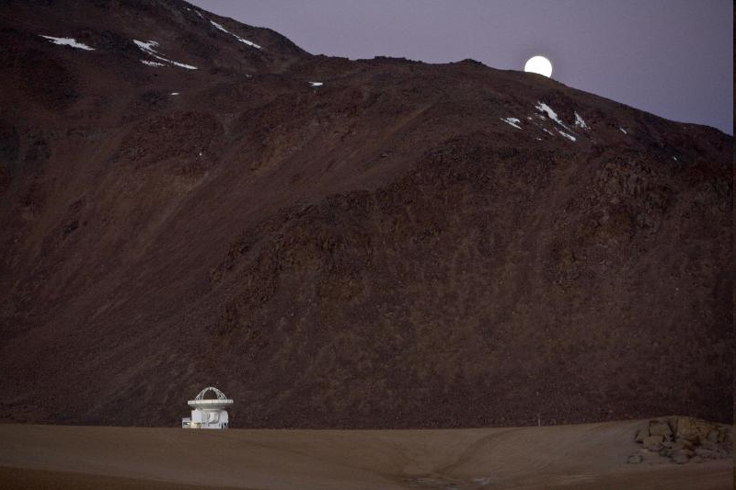
ESO Today
La Silla and Paranal Observatory in full operations
(7 telescopes in 2009, plus four telescopes for interferometry)
APEX in operations on Chajnantor
ALMA under construction (early science in 2011, full operations in 2013)
Operational data archive
European Extremely Large Telescope in design phase
Headquarters in Garching, Germany
Representation in Santiago, Chile

Slide 5
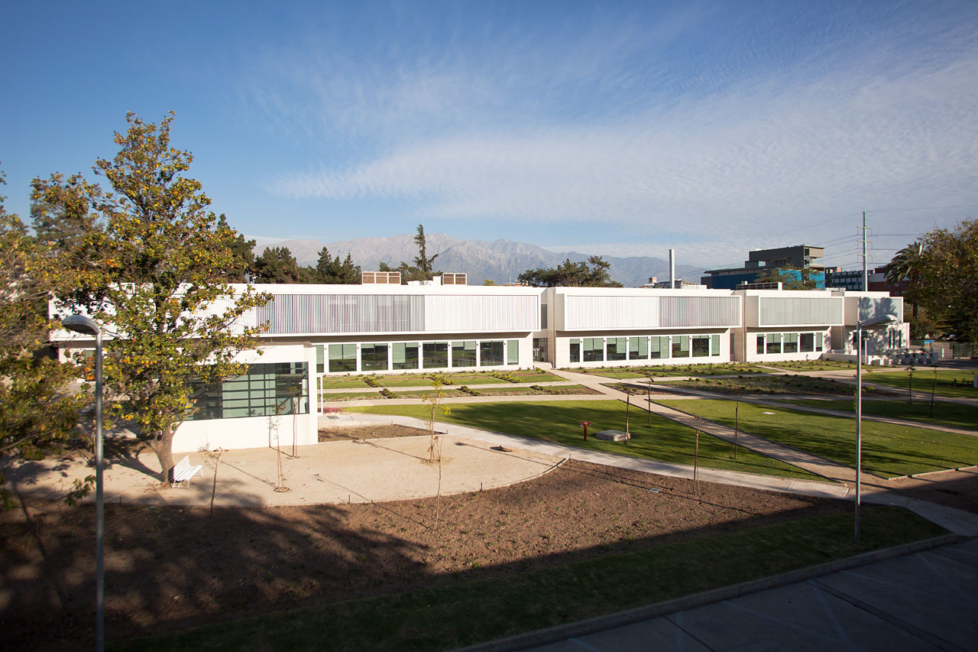
ESO Today
La Silla and Paranal Observatory in full operations
8 (soon 9) telescopes in 2011, plus four telescopes for interferometry)
APEX operating on Chajnantor
ALMA under construction (early science in 2011, full operations in 2013)
Operational data archive
European Extremely Large Telescope in design phase
Headquarters in Garching, Germany
Representation in Santiago, Chile

Slide 6
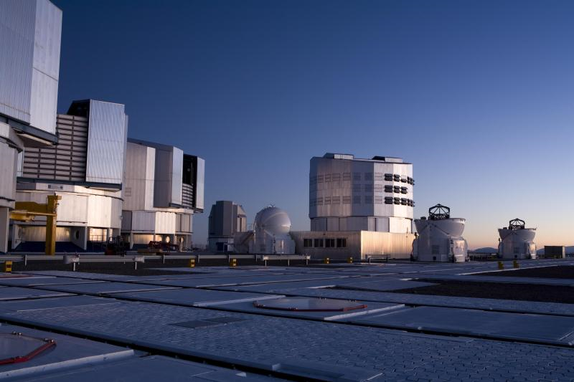
La Silla Paranal
VLT/I (Paranal)
  Instrumentation operating, in assembly and planned
    Covers the available optical infrared wavelengths
    300nm to 20μm
    Angular resolution from seeing limit to 50 μ-arcseconds
    FORS2, ISAAC, UVES, FLAMES, NACO, SINFONI, CRIRES, VISIR,
    HAWK-I, VIMOS, X-Shooter, laser guide star facility
    KMOS, MUSE, SPHERE, Adaptive Optics Facility
    MIDI, AMBER, PRIMA, GRAVITY, MATISSE
La Silla
  Continue operations with long-term programmes
    HARPS, EFOSC2, SOFI, visitor instruments
APEX
    Covers sub-mm and mm wavelengths 0.3 to 3 mm
    SHFI (Swedish Heterodyne Facility Instrument), LABOCA, SABOCA, APEX-SZ, CHAMP+, FLASH

Slide 7
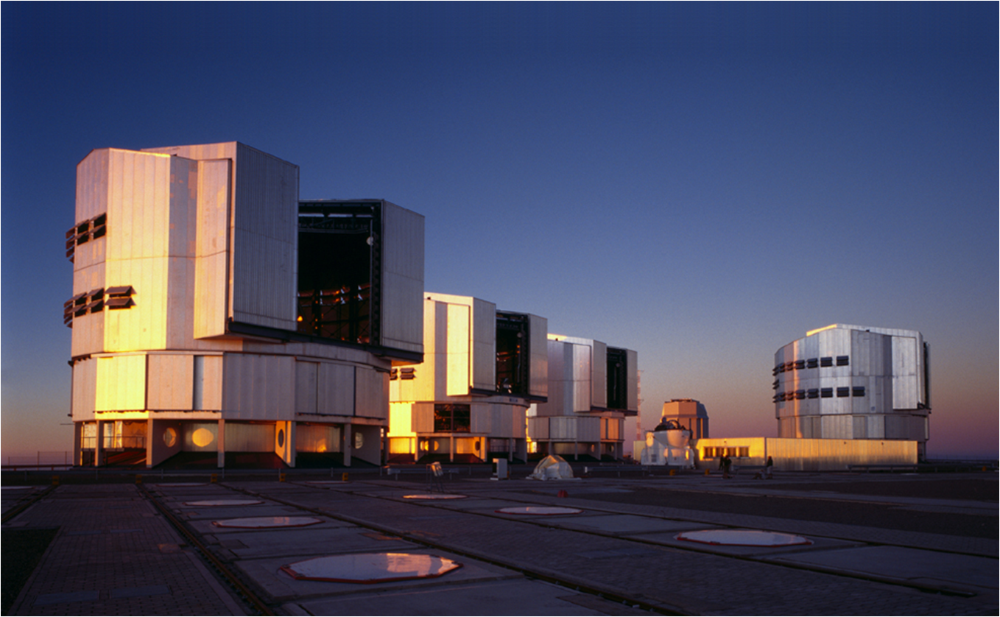
La Silla Paranal
VLT/I (Paranal)
  Instrumentation operating, in assembly and planned
    Covers the available optical infrared wavelengths
    300nm to 20μm
    Angular resolution from seeing limit to 50 μ-arcseconds
    FORS2, ISAAC, UVES, FLAMES, NACO, SINFONI, CRIRES, VISIR, HAWK-I, VIMOS, X-Shooter, laser guide star facility
    KMOS, MUSE, SPHERE, Adaptive Optics Facility, ESPRESSO
    MIDI, AMBER, PRIMA (astrometry), (PIONIER), GRAVITY, MATISSE
    VISTA/VIRCAM
    VST/ΩCam

Slide 8
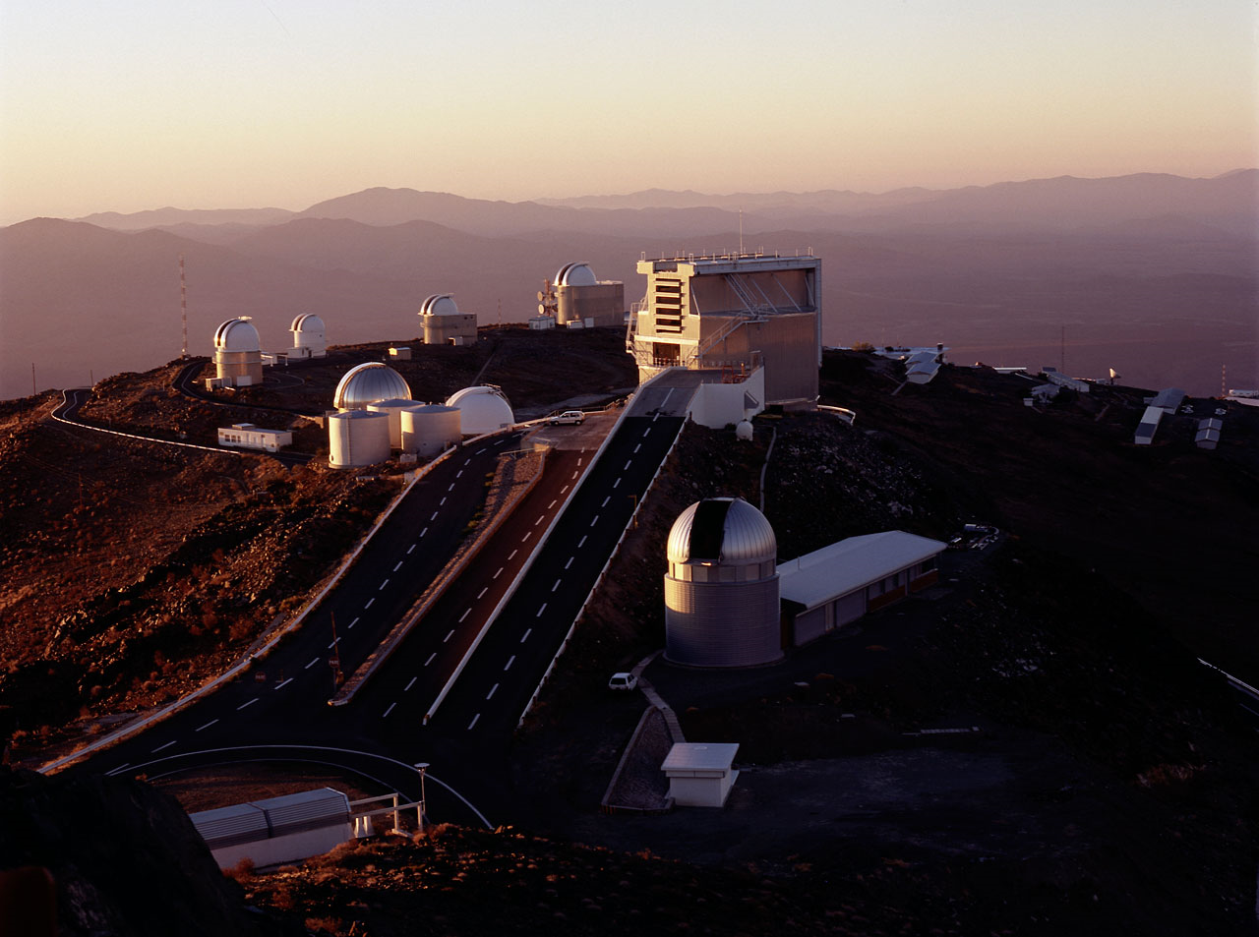
La Silla Paranal
La Silla
  Continue operations with long-term programmes
    HARPS, EFOSC2, SOFI, FEROS, WFI, visitor instruments
APEX
    Covers sub-mm and mm wavelengths 0.3 to 3 mm
    SHFI (Swedish Heterodyne Facility Instrument), LABOCA, SABOCA, APEX-SZ, CHAMP+, Z-Spec

Slide 9
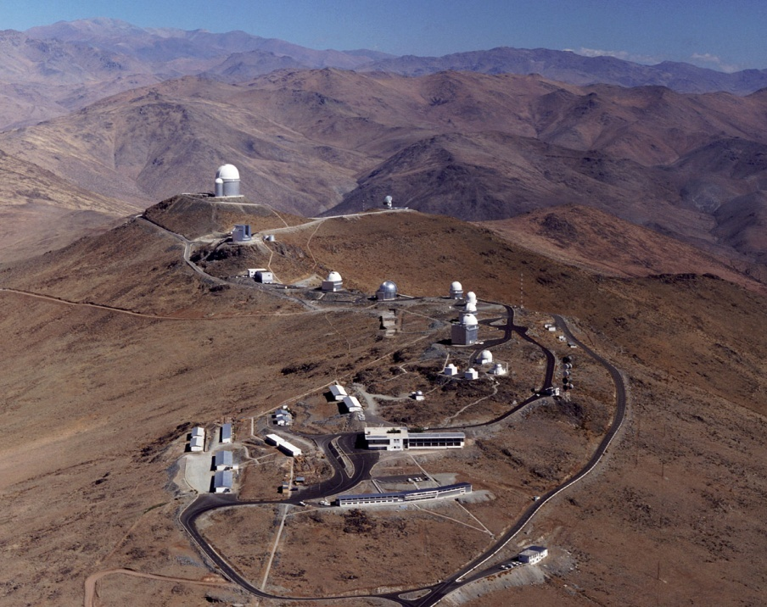
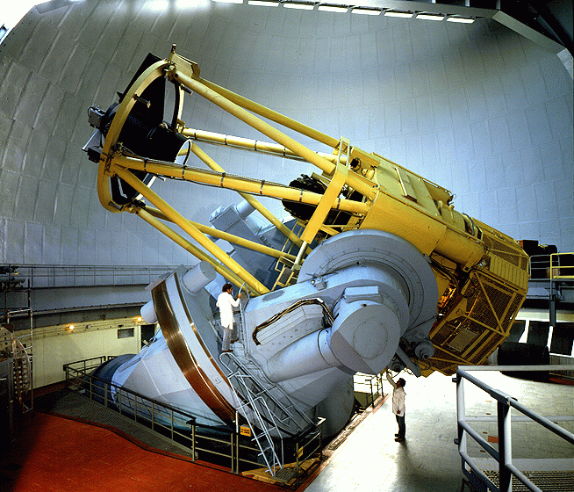
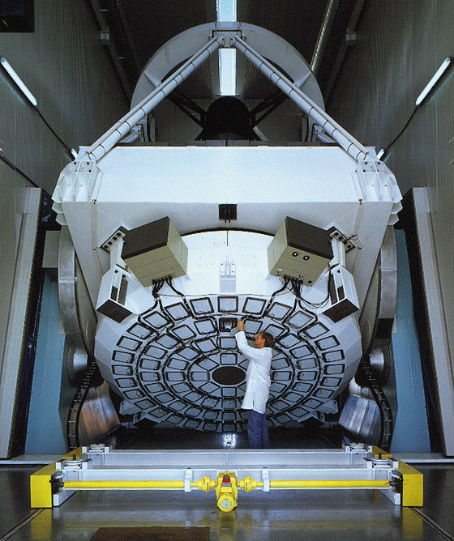
La Silla
Medium-size telescopes
  3.6m: HARPS for exo-planet searches
  3.5m NTT: EFOSC2, SOFI
  & visitor instruments
  2.2m: WFI & FEROS in partnership with MPG
Small telescopes
  Closed/funded externally
“Platform” for initiatives and specific experiments
  Euler, Tarot-II, REM, QUEST, TRAPPIST

Slide 10
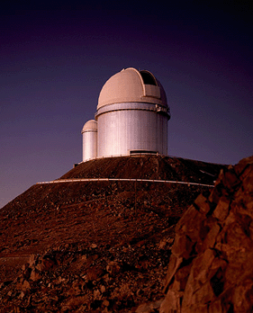
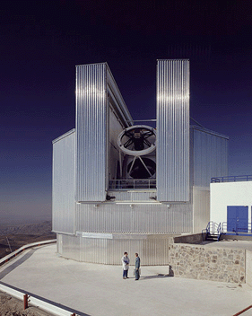
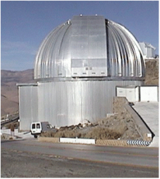
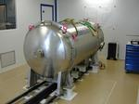
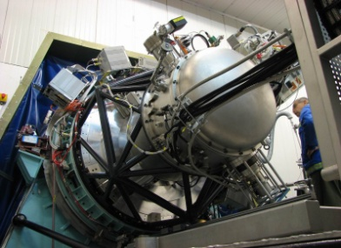
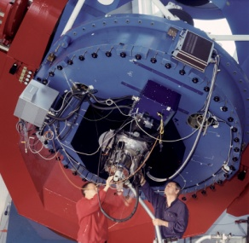
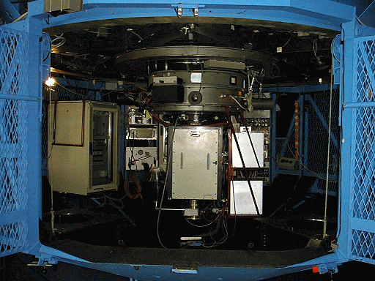
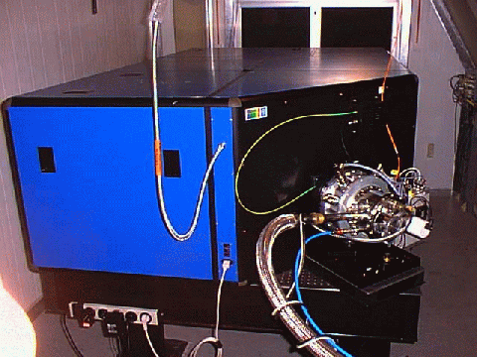
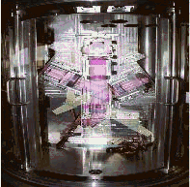
La Silla: 5 Operational Instruments
3.6m
NTT
2.2m
HARPS
SOFI
WFI
EFOSC2
FEROS
GROND

Slide 11
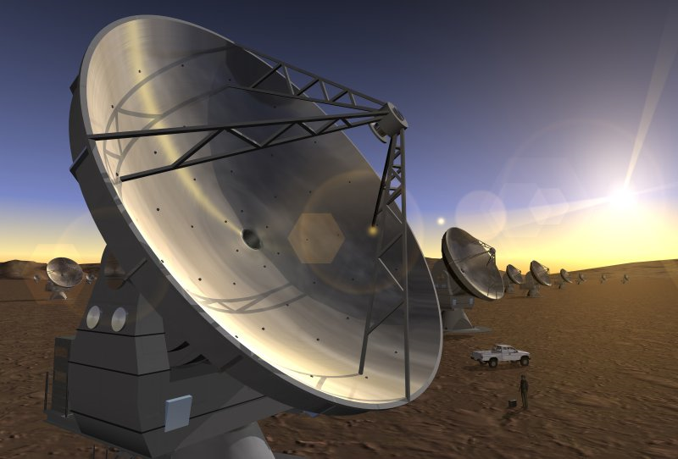
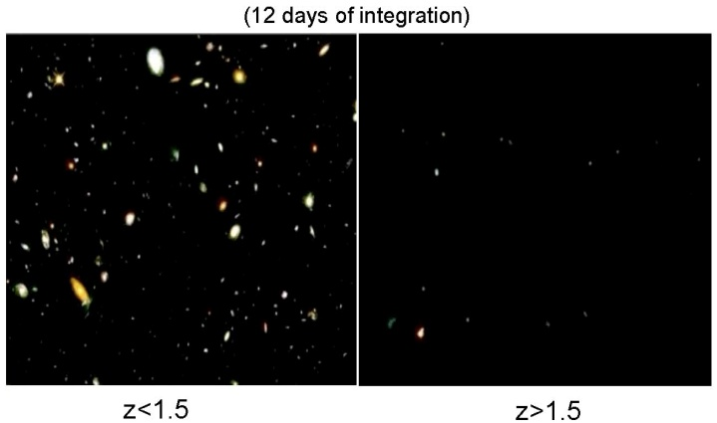
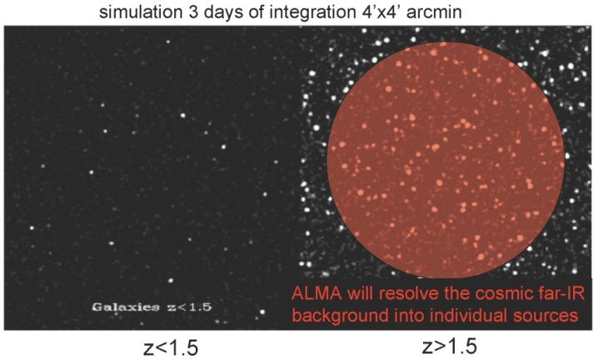
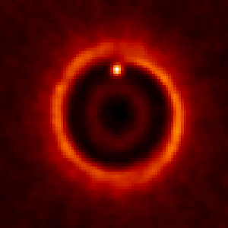

ALMA
Science requirements
  Detect CO and [CII] in Milky Way galaxy at z=3 in < 24 hr
  Dust emission, gas kinematics in proto-planetary disks
  Resolution to match Hubble, JWST and 8-10m with AO
  Complement to Herschel
Specifications
  66 antennas (54x12m, 12x7m)
  14 km max baseline (< 10mas)
  30-1000 GHz (10–0.3mm), up to 10 receiver bands
HST
ALMA
5AU
850 GHz

Slide 12
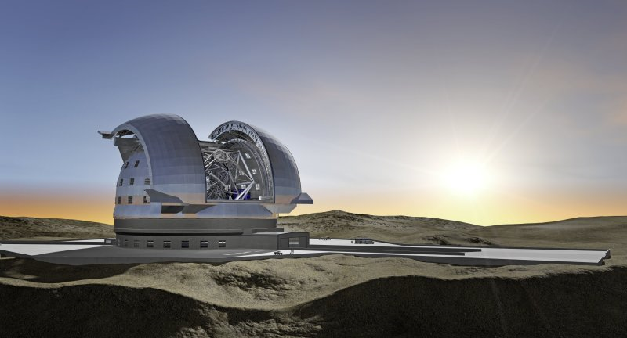
E-ELT
Detailed design study
  Baseline 42m primary mirror
  Adaptive optics built-in
  Industry strongly engaged
  Study complete in 2010
Project
  Builds on entire expertise at ESO and in the member states
  Construction 2011-2018
  Synergy: JWST/ALMA/SKA

Slide 13
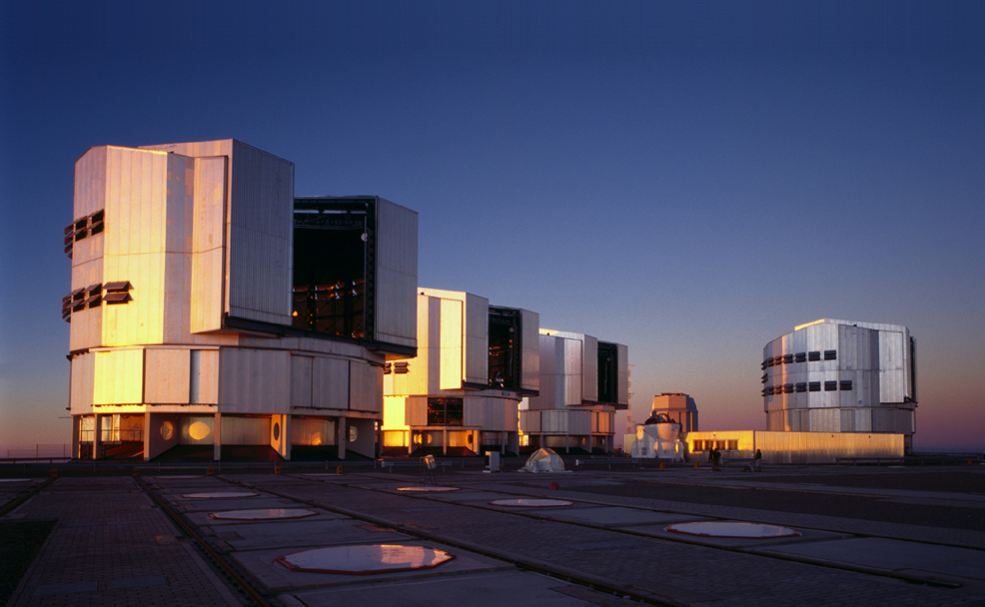
Paranal

Slide 14
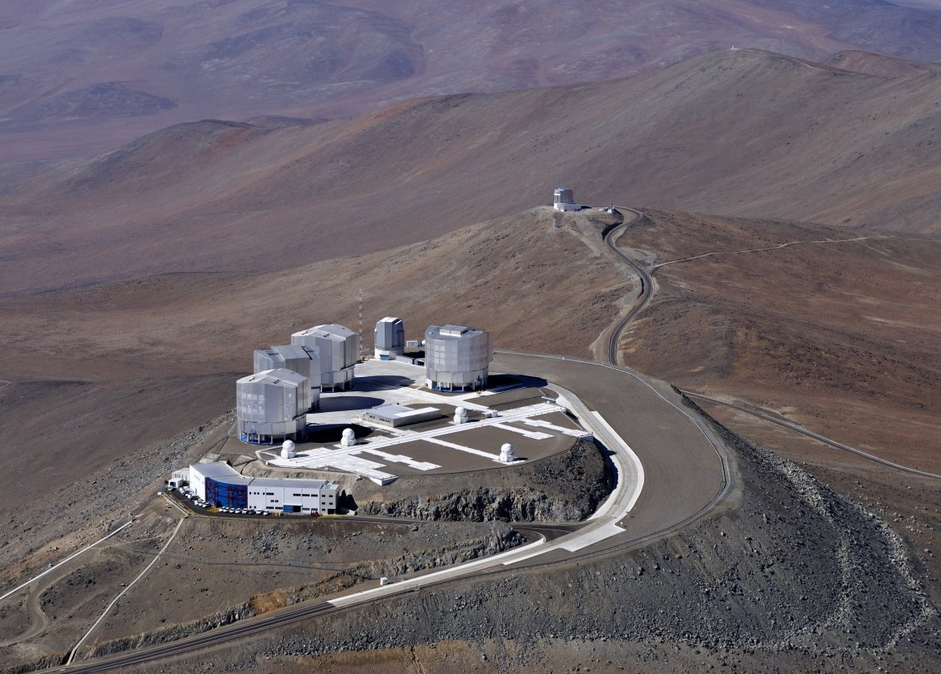

Slide 15
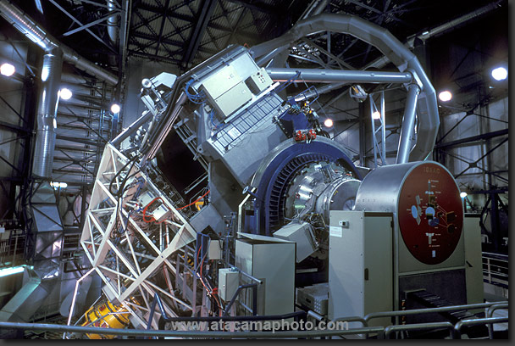

Slide 16
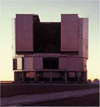
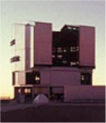
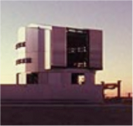
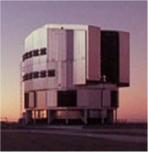
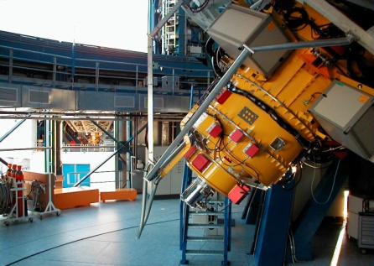
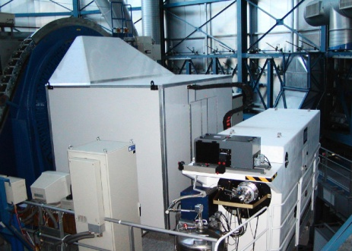
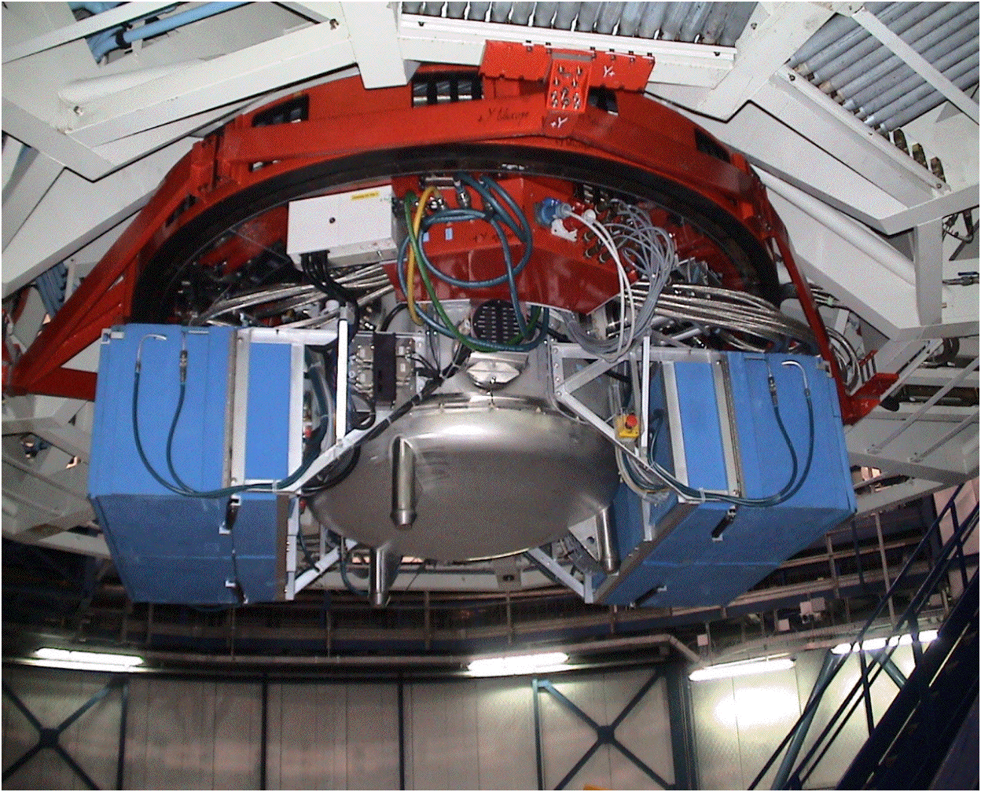
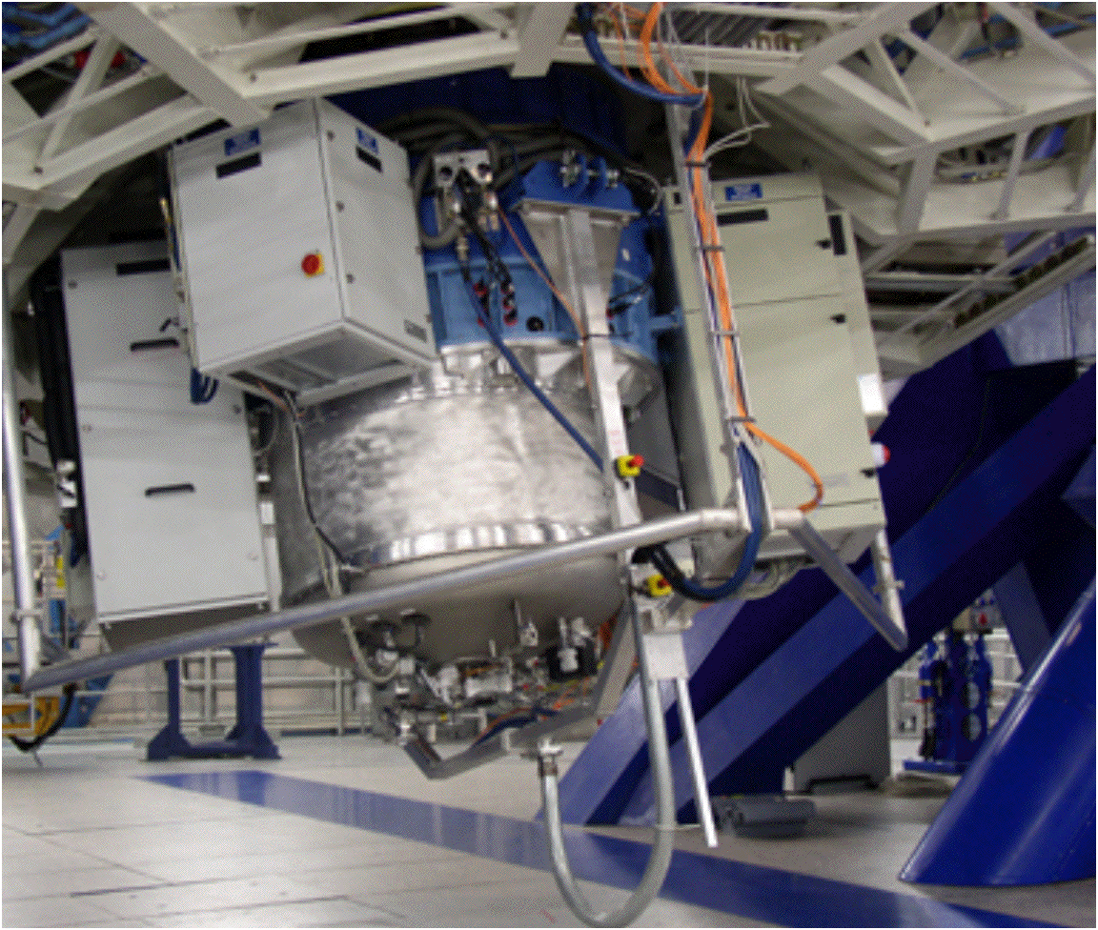
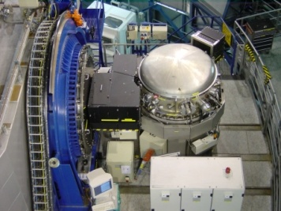
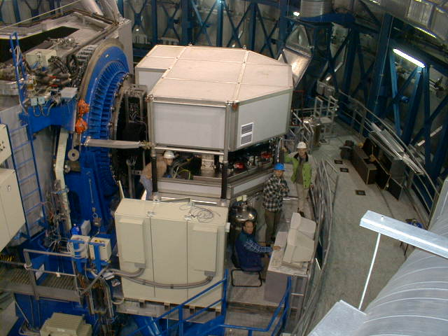
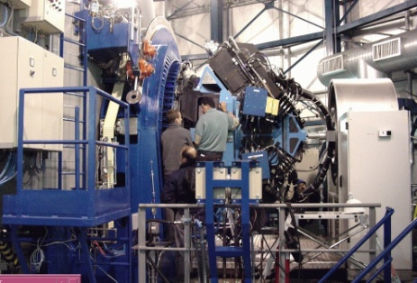
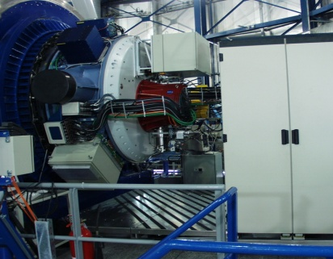
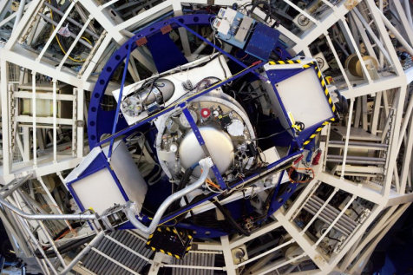
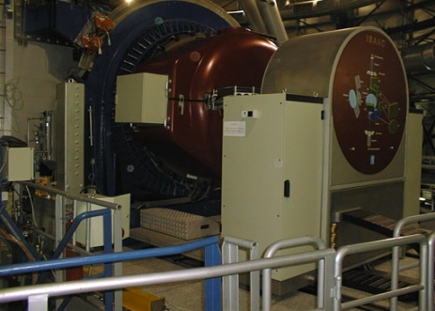
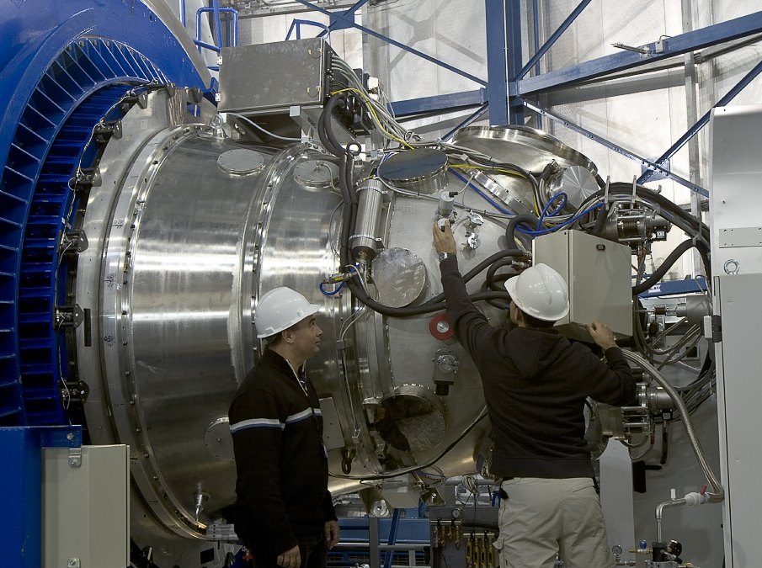
VLT Instruments
FORS2
FLAMES
VISIR
SINFONI
CRIRES
UVES
VIMOS
NACO
X-shooter
ISAAC
HAWK-I

Slide 17
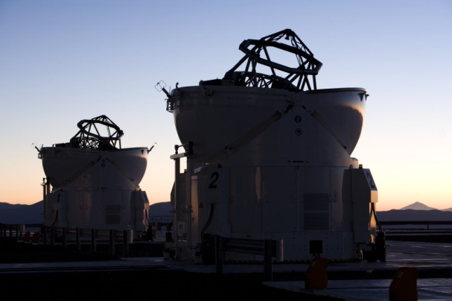
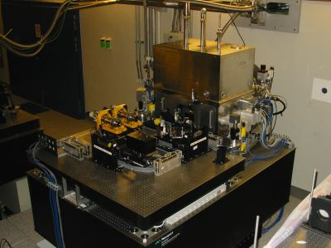
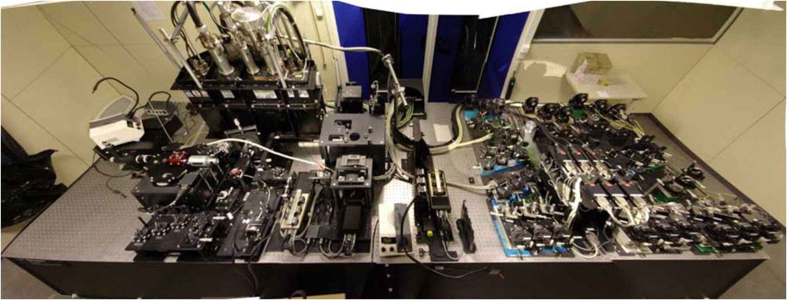

VLTI Instruments
MIDI
AMBER

Slide 18


Rapid Response Mode (RRM)
UVES observations of
GRB 060418
10 minutes
after the initial
Swift trigger
Many metal line systems
at 3 redshifts.
[Zn/Fe] >> QSO abs.

Slide 19

VISTA
VISTA in operations since April 2010
Multi-year programme of large public surveys
VST
VISTA

Slide 20

VISTA
Science Verification finished
  NGC 253 and Orion
Public Surveys started
  VHS, VVV, VIDEO, VIKING, VMC, UltraVISTA

Slide 21

VST
Final assembly and systems tests ongoing
Surveys possibly will start in mid-2011
Review of the public surveys in September 2010
  surveys were originally selected in 2005
VST

Slide 22
Top list of ESO science
Galactic Centre
  Supermassive black hole
Extrasolar planets
  First images of exo-planets
  Lightest known planets
Accelerating Universe
  Spectroscopy of distant supernovae
Gamma-Ray Bursts/Supernovae
  Explosion physics
  Tracers of the distant universe

Slide 23
Other top science from ESO
Metal-poor stars
  Tracing the chemical enrichment
  Finding the oldest known stars
Stellar populations in nearby galaxies
  Measuring stars beyond the Local Group
Massive galaxies in the distant Universe
  Puzzles in galaxy formation
Varying physical constants?
  Measure the fine-structure constant over time
Testing the cosmological model
  Cosmic background temperature

Slide 24
More top science
Detecting and imaging the torus around AGN
Measure the geometric shape of stars
Determine the size of stars
  E.g. Cepheids to calibrate the period-luminosity relation
Star formation
  Debris disks, chemistry in circumstellar disks
Measure the structure of the Milky Way
  Local spiral arm
  Bulge, disk and halo, run-away stars
Solar System objects
  Comets, asteroids, weather on Titan

Slide 25

Proposing for ESO time
Call for proposals will be published in two weeks
(1 March 2011)
P88
Proposal deadline: 31 March 2011, 12:00 noon CEST

Slide 26
Proposal types (P88)
4 proposal types all handled by OPC
  normal programmes
  large programmes
  Target of Opportunity
  calibration programmes
    all considered by the OPC
Director Discretionary Time
    submission any time
    decided by ESO Director General
ESO/GTC time
  20 nights to be allocated through P88
    only ‘large programmes’ (at least 10 nights)
    recommended by OPC and the ESO/GTC liaison committee

Slide 27
Structure of the ESO OPC
Observing Programmes Committee
  4 scientific categories
    Cosmology (A)
    Galaxies and Active Galactic Nuclei (B)
    Interstellar Medium, Star Formation and
    Planetary Systems (C)
    Stellar Evolution (D)
  13 panels
    3 for category A
    2 for category B
    4 each for categories C and D

Slide 28

ESO Proposals – strong competition
1977
2010

Slide 29

Why?

Slide 30
ESO proposals
Pressure factor typically high
  typical oversubscription for ESO telescopes is >3
    often reaching 5 and in certain periods/RA ranges 8 or higher
  Large Programmes have an acceptance rate of about 20% or less
  Pressure on ToO proposals is extremely high
    GRBs, supernovae, novae, stellar occultations by TNOs, microlensing

Slide 31

Call for Proposals
Important document
  contains a lot of relevant information
  especially important for first-time
  users
  contains many useful links
  to instrumentation and other useful
  information
  binding document, if proposal is approved
P88
Proposal deadline: 31 March 2011, 12:00 noon CEST

Slide 32

High pressures
Some right ascensions are already in high demand

Slide 33

Call for Proposals
Everybody must read

Slide 34
Call for Proposals
Find the appropriate instrument

Slide 35
What makes a proposal successful?
Exciting science
  provide clear progress in our understanding of some phenomenon
A neat idea
  unusual method, new idea, new approach,
  unique observation or experiment
Clear language
  presentation of an exciting story, which is interesting for many people
  cover all questions somebody may have
  information to the point

Slide 36
What makes a proposal successful?
A consistent story
  the proposal is complete and provides all information
  quantitative arguments for the amount of time requested
Good match of observations and instrument
  make sure you pick the most suited instrument for the observations
  explain the choice
Good Luck!

Slide 37
ESO Archive
The ESO data archive
  is a rich source of excellent data
  abstracts of previous proposals available
  data public one year after they have been delivered to the PI
  great way to compete with your competitor, if they got observing time
  easy retrieval and selection of calibration data

Slide 38
Get involved
Participate in OPC
Participate in other ESO activities
  get to know the organisation better
  active interactions with ESO people
Have a lively scientific exchange with the (European) astronomical community
  conferences, workshops
  regularly publish your results

Slide 39
Apply!
Only 5% of the requested time comes from Spanish PIs or CoIs (P87)
Allocation at the moment is even lower (~3%).
Remember – this is an international competition
  explain why your project is interesting
  use simple language – keep it simple
  try to think like the referee/panel member
    why is this interesting
    why should my proposal be chosen above others
    can the proposal be understood quickly, e.g. from the abstract alone?
    are the figure supporting my story?
    are they clear and to the point?

Slide 40





ESO’s goals for next five years
Best science from La Silla Paranal Observatory
  Second generation instruments (VLT/VLTI)
  Key surveys with VST and VISTA
  Long-term programs for unique science on La Silla
  Prepare for ALMA science with APEX
Deliver ALMA on time and budget
Design world-leading E-ELT, and secure funding for construction and operations

